Slide 1

Title
Hospital Management System
By Shivam Pandey
Notes:
To change the image on this slide, select the picture and delete it. Then click the Pictures icon in the placeholder to insert your own image.

Slide 2
Introduction
Objective: Develop a system to manage hospital data such as doctors and patients.
Technologies Used:
Java
MySQL
Hibernate

Slide 3
Project Overview
Features:
Add and View Patients
Add and View Doctors
Book Appointments
Components:
Doctor Class
Patient Class
Hospital Management System Main Class

Slide 4
Objective
The Hospital Management System aims to streamline and automate the management of hospital operations by providing a robust application to:
Efficiently Manage Doctor and Patient Records: Allow users to add, view, and update information about doctors and patients.
Facilitate Appointment Scheduling: Enable booking and management of doctor appointments to enhance patient care.
Improve Data Accessibility and Accuracy: Use a centralized database to maintain up-to-date and accurate records, ensuring efficient information retrieval and management

Slide 5
Technology Used.
JAVA:-Java is a most popular, object-oriented, widely used programming language and platform that is utilized for Android development, web development, artificial intelligence, cloud applications, and much more. So, mastering this gives you great opportunities in bigger organizations.
MYSQL:-MySQL is a relational database management system based on the Structured Query Language, which is the popular language for accessing and managing the records in the database.

Slide 6
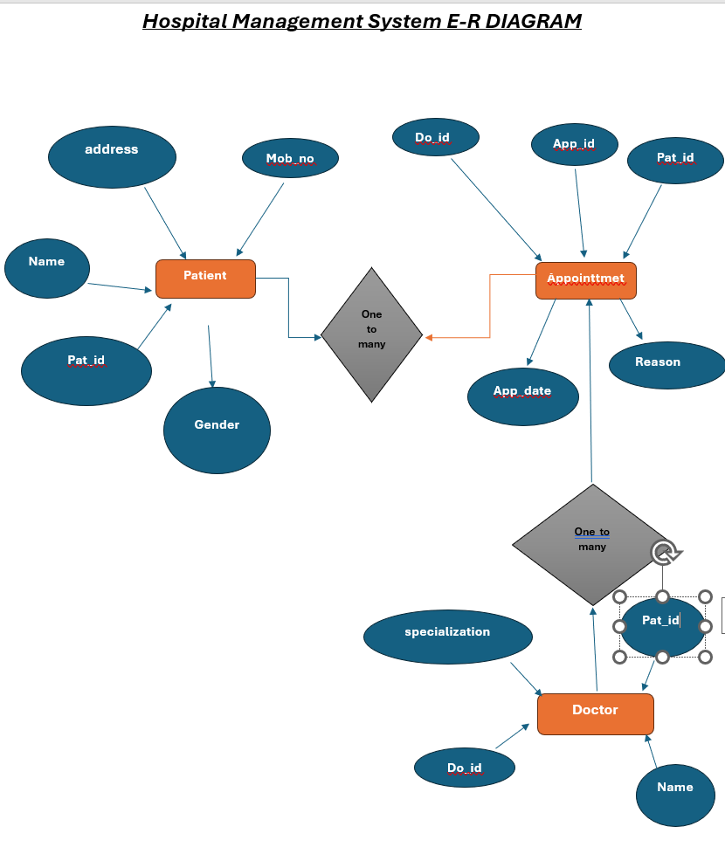
Database Design
Structure:
Organized into interconnected tables for Patients,
Doctors, Appointments, Billing, and Medical Records.
Key Relationships:
One-to-Many: Doctors to Appointments, Patients to Medical Records.
Many-to-Many: Patients with multiple Doctors and vice versa.
Optimization:
Normalized database ensures minimal redundancy and maintains data integrity.
ER Diagram:
A simplified diagram to illustrate entity relationships.

Slide 7
Module
Doctor
Patient
Appointment
HospitalMangementSystem

Slide 8
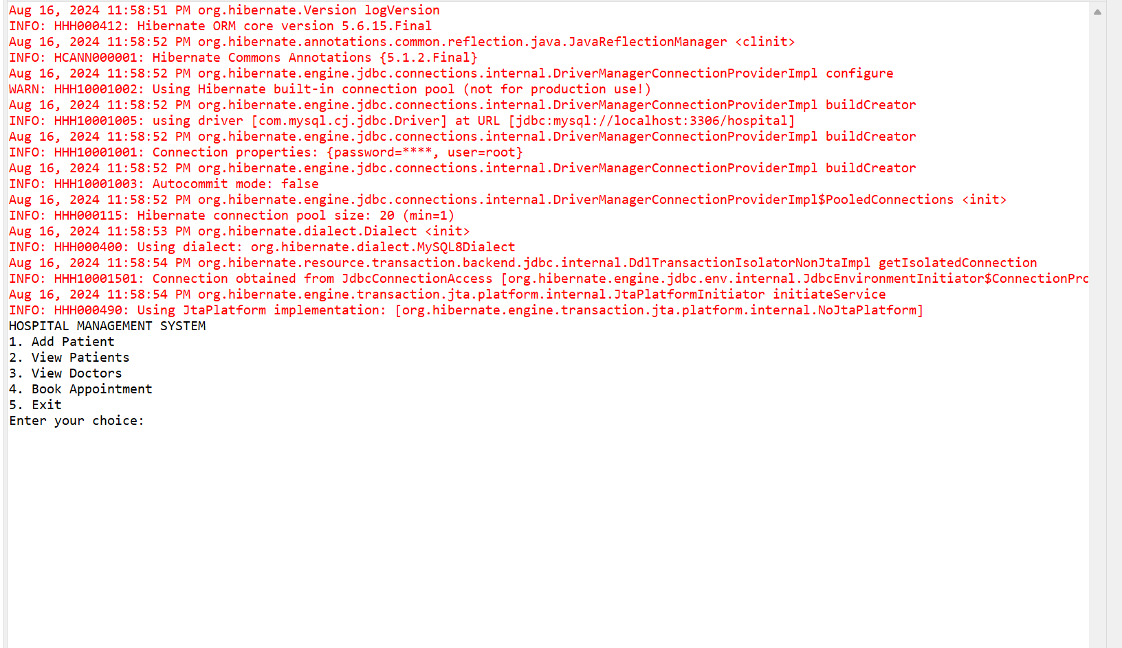
User Interface
Design Focus:
User-friendly, efficient, and consistent across all modules.
Core Features:
Dashboard: Summary of key metrics.
Patient Management: Easy record handling.
Appointment Scheduler: Calendar view for booking.
UX Highlights:
Accessibility: Role-based access.
Responsiveness: Adapts to different devices.
Visuals:
Screenshots showcasing interface design.

Slide 9
Doctor
Delete a Doctor
View Doctor by ID
View Doctor by ID
Some of the features and functionalities of Doctor Module
Add a Doctor
Update Doctor Information
Delete a Doctor
View Doctor by ID

Slide 10
Patient
Some of the features and functionalities of the Patient Module include:
Adding and editing patient information
Viewing patient
Scheduling appointments and managing patient visits

Slide 11
System Design
The Hospital Management System (HMS) is a Java-based application that manages hospital records, including doctors and patients, and allows booking appointments. It utilizes Hibernate for database operations and follows a console-based interaction model.

Slide 12
Benefits
Enhanced Functionality and Flexibility
Improved Data Management
Better User Experience
Enhanced Administrative Control
Data Integrity and Accuracy
Efficient Database Management

Slide 13
Conclusion
Overall, this project demonstrated the importance of utilizing technology to improve healthcare services, and it serves as a valuable example for other organizations looking to implement similar systems. With further improvements and updates, this system has the potential to transform healthcare services and improve patient outcomes.

Slide 14

End

